Slide 1
Software Innovation Studio
Team
Graphics created by Ullupta conecum re volupta evelignis pe et doluptuam.

Slide 2
Recyclenator
Recycle em, Reuse em, Stick em in the bin

Slide 3
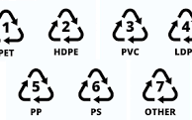
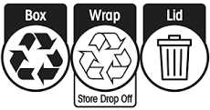
Project Scope (What)
RecycleNator employs advanced machine learning to distinguish Resin Identification Codes from recycling symbols, frequently misinterpreted, in order to ascertain an item's recyclability. It subsequently provides personalized recycling instructions, facilitating environmentally conscious choices.
It is currently limited to the laws of NSW, and to scalable web app which will be accessible on any device

Slide 4
Background Research and Users’ Needs (why and who)
Pain Point: Difference between Mobius Loop & PIC
84% to 96% are recycled from yellow bin, ~16% not recycled due to lack of knowledge
26% of Australians felt they had limited knowledge on recycling and soft plastics recycling (Wheeler, 2020)
Plastic is particularly confusing considering its various forms and disposal differences across different councils (FoodMag, 2020)
Targeting the 16% - 26% of Australians
Education + human cantered process; off load the thinking to machines
Similar products: Recycle Mate & RecyClean (only mobile)

Slide 5
Background Research and Users’ Needs (why and who)
Address the Users’ pain point(s) / need(s) / requirements with supported references
The reference can be from news, daily life, research question …
=> Highlight the problem (s) / requirement (s) is (are) important and valuable
The similar ideas, products or solutions in the market. What, why and how you can do better?

Slide 6
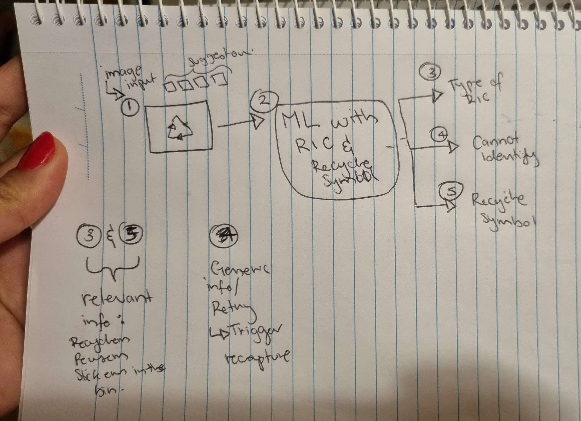
Expected Prototype / Achievements (What)

Slide 7
The Tech (How)
YOLOv8 (or similar) single shot ML

Slide 8
Your Team and Members
List the team members and their roles in this project
Link the proposed achievements with your team members

Slide 9
Project Timeline
According the proposed achievements in this semester, you should list the timeline
# of sprint should be clearly identified (>= 3 sprints)
funding plans and deliverable in every sprint
The small demo after every single sprint is expected

Slide 10
Thank you

